Slide 1
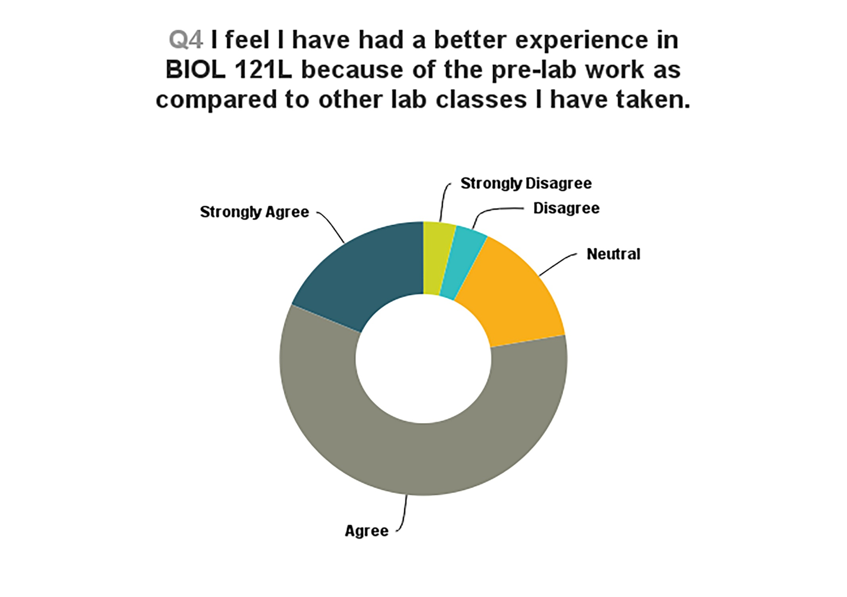
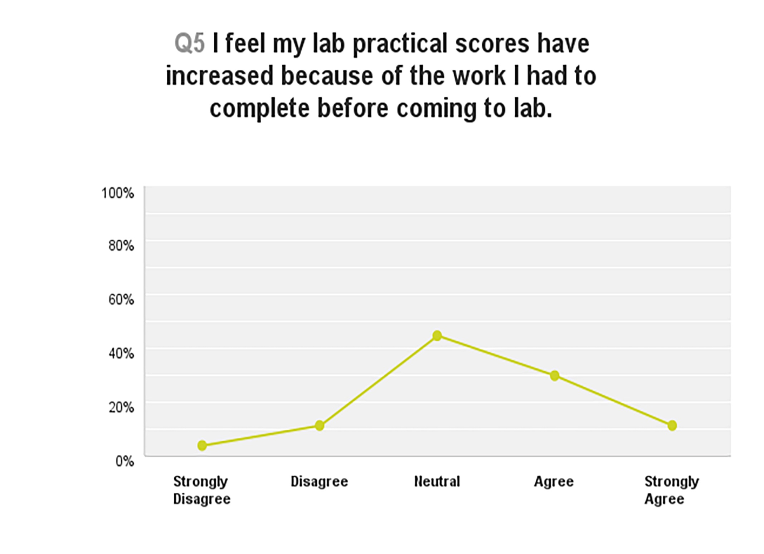
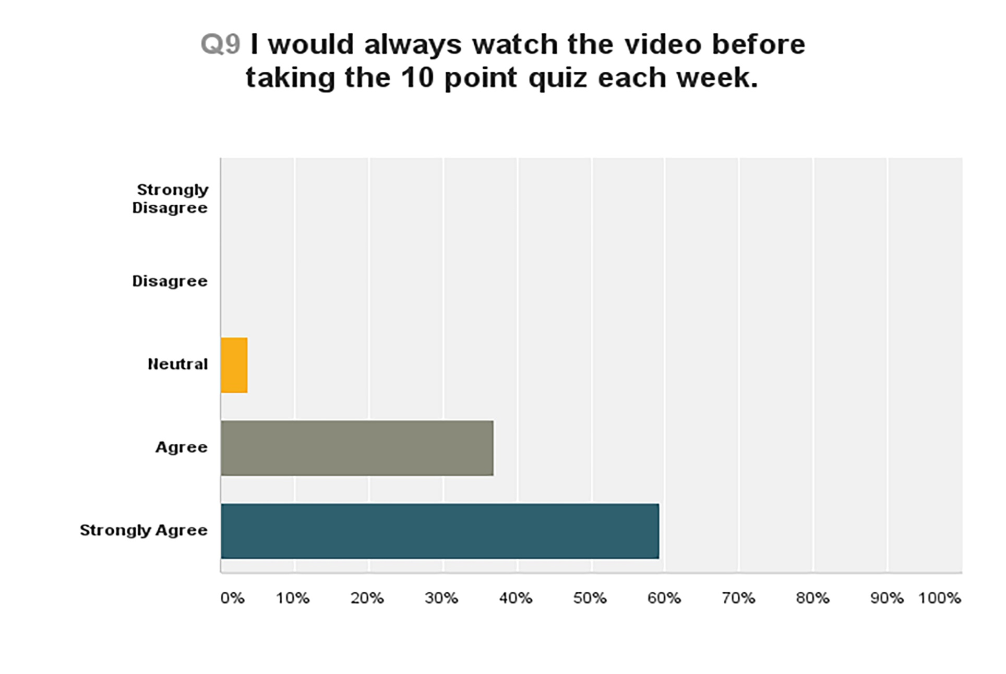
How Effective is the Flip?
Student Perspectives and Faculty Challenges Implementing the Flipped Classroom
Betsy L. Diegel, EdD
Qualitative Testimonials
Liked knowing what we were doing ahead of time
Hit the ground running- begin with learning not listening
I wouldn’t have pre-read otherwise, only would have done what was due that day.
Great and very beneficial
Watching the video set the tone of what was expected in class.
Add cumulative questions to quiz each week
Want this method again in future
Instructor spoke too fast in some of the videos
Results
Background
77% of students had a better experience in BIOL 121L because of pre-lab work as compared to other lab classes.
78% of students had more confidence in lab each week because of the pre-lab work and completing the 10 point quiz.
92% of students liked knowing what was covered before coming to lab.
81% of students felt they could participate more during lab.
38% of students felt their lab practical scores increased because of the work they had to complete before coming to lab.
Too much time spent lecturing to prepare students for lab activities.
Blend traditional lab format to flipped classroom approach during semester long course.
Increase student preparedness and accountability through an innovating teaching strategy.
Provide students with familiarity of lab equipment, anatomical models, and procedures before lab begins.
Purpose of the Study: To investigate if using the flipped classroom model increases BIOL 121L retention of course content and lab practical scores.
Accountability
Application
Acclimation
Implications for Future Practice
Set mandate to complete by certain day of the week.
Create questions that build from previous weeks’ material.
Revise some of the videos to increase quality for the viewer.
Investigate the notion of increased student confidence being attributed to this approach.
Methods & Design
Blackboard was the online platform used.
Weekly recorded videos via Flipcam
Students take weekly online 10 point quiz.
End of course survey- Quantitative
Follow up Student Focus Group- Qualitative
Requirement to listen and learn from the pre-recorded video before coming to lab.

