Slide 1
HONORS SOCIETIES
RESEARCH COLLOQUIUM
SPRING 2010

Slide 2

University Success 103
Investigating Various Models to Improve Student Learning
Dr. Kevin Thrasher
Center for Learning and Advancement
Dr. Jim Helfers
College of Liberal Arts

Slide 3
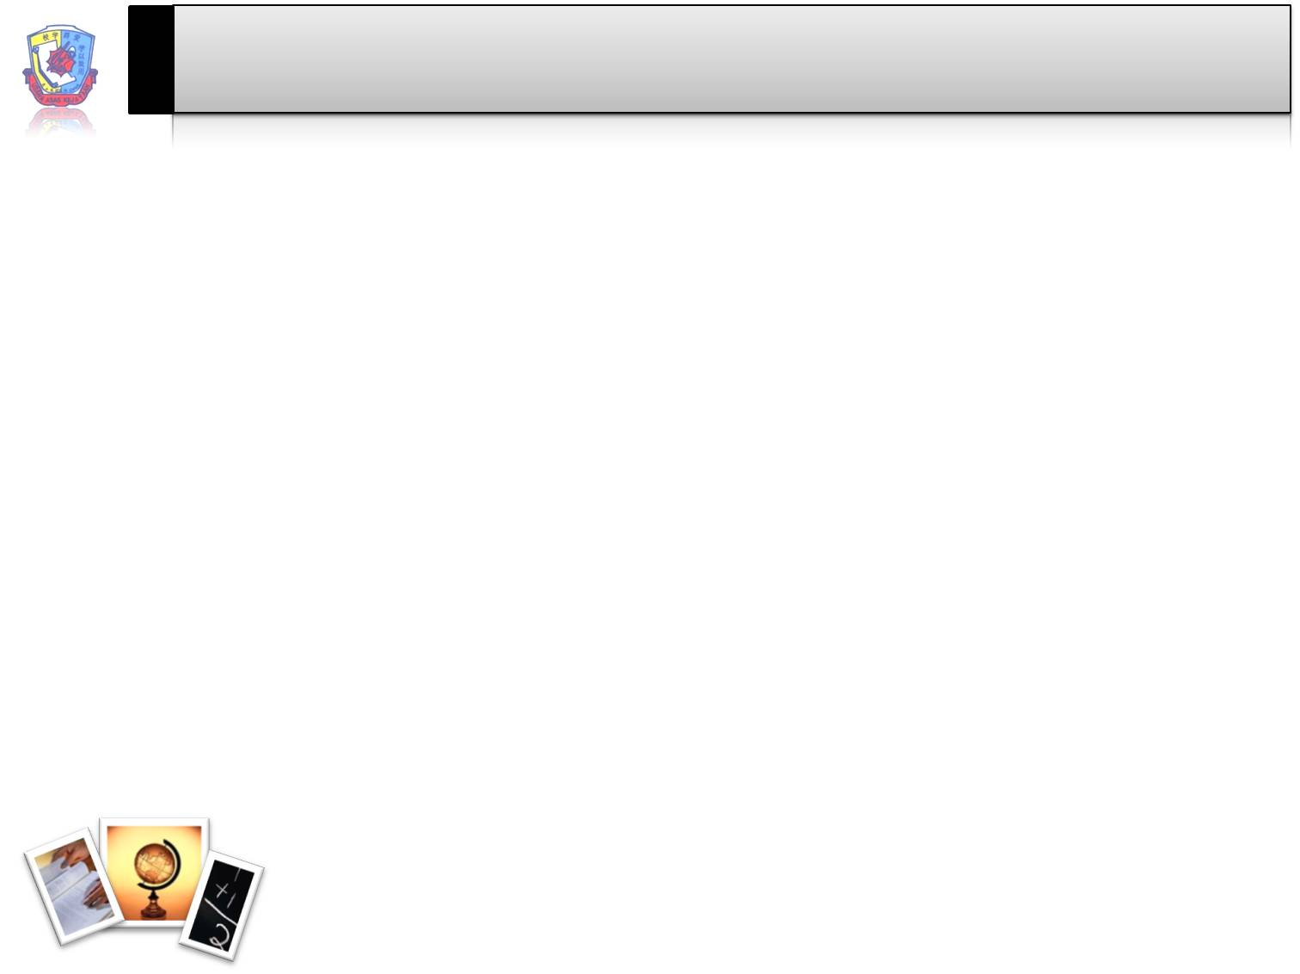
Overview and Purpose of Study
Purpose:
  The study will examine different interventions on the success of students in the UNV103 ground courses during the Spring 2010 start.
The Interventions:
  Pearson Publishing, MySkills Lab
  Workshops developed by Grand Canyon University’s Center for Learning Advancement
Sample demographics:
  2 control sections: 38 active students, 23 dropped/inactive
  1 section enhanced with workshop material, Pearson MySkills Lab: 28 active students, 8 dropped/inactive
  2 sections enhanced with workshop material: 54 active students, 15 dropped/inactive

Slide 4
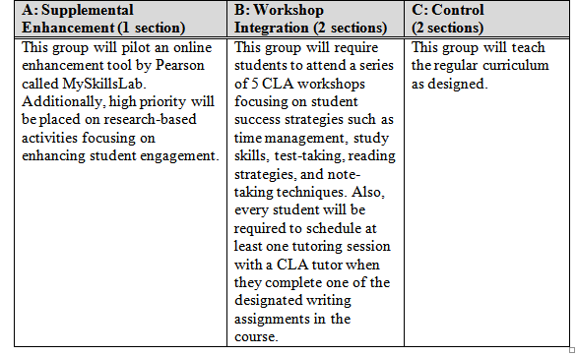
Group Conditions

Slide 5
Each group will be analyzed according to three variables:
1) Pre- and post-test scores on the GCU Writing Placement Test in ANGEL (50 item, multiple choice test),
2) Student satisfaction as measured by surveys (EOCS), and
3) Student retention as indicated by the number of students who stay enrolled in the course and continue to the next course.
Additional measures could include anecdotal student stories from the EOCS and grades.

Slide 6
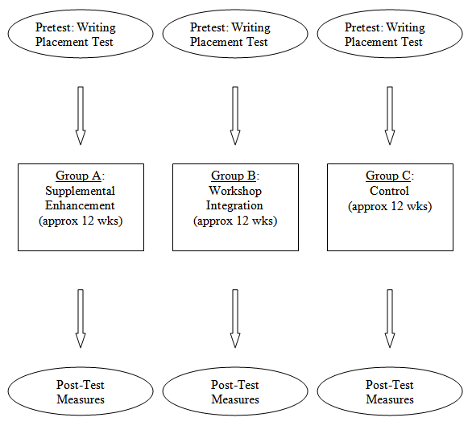
Methodology & Design

Slide 7
Limitations & Possible Confounding Variables
CLA workshops are open to all students
Faculty involved in this study are all engaged with the CLA and its services.
Varying amounts of faculty enhancement of courses
Instructor experience and ability
However, 1 &2 should not be a serious problem since it is a variable to which all groups are exposed.

Slide 8
Conclusions (Expectations)
The experimental groups will evidence statistically significant differences in student success and persistence across courses.
The study’s results will suggest interventions for our online population in UNV 103 (interventions appropriate to online will be tested in a later iteration of the study).

